Slide 1

C++ & DSA PLACEMENT COURSE
Khaiser Khanam

Slide 2

ARRAY
DATA STRUCTURE

Slide 3
What is an Array?
How to Declare an Array
Initializing array
Accessing Array Elements
Why Use Array?
Printing all array elements
Memory Representation of Array
Types of Arrays
Array with functions
Find length of array
Good and Bad Practice
Storing characters

Slide 4

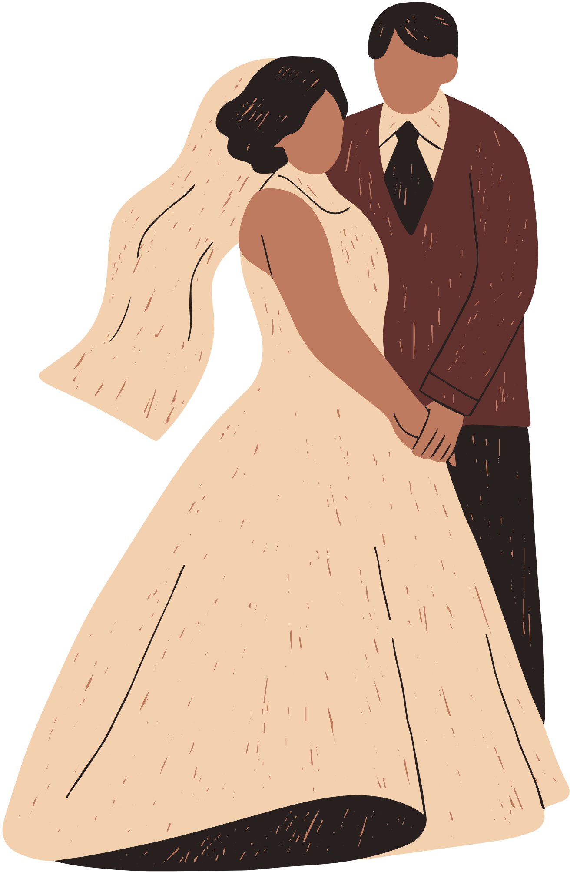
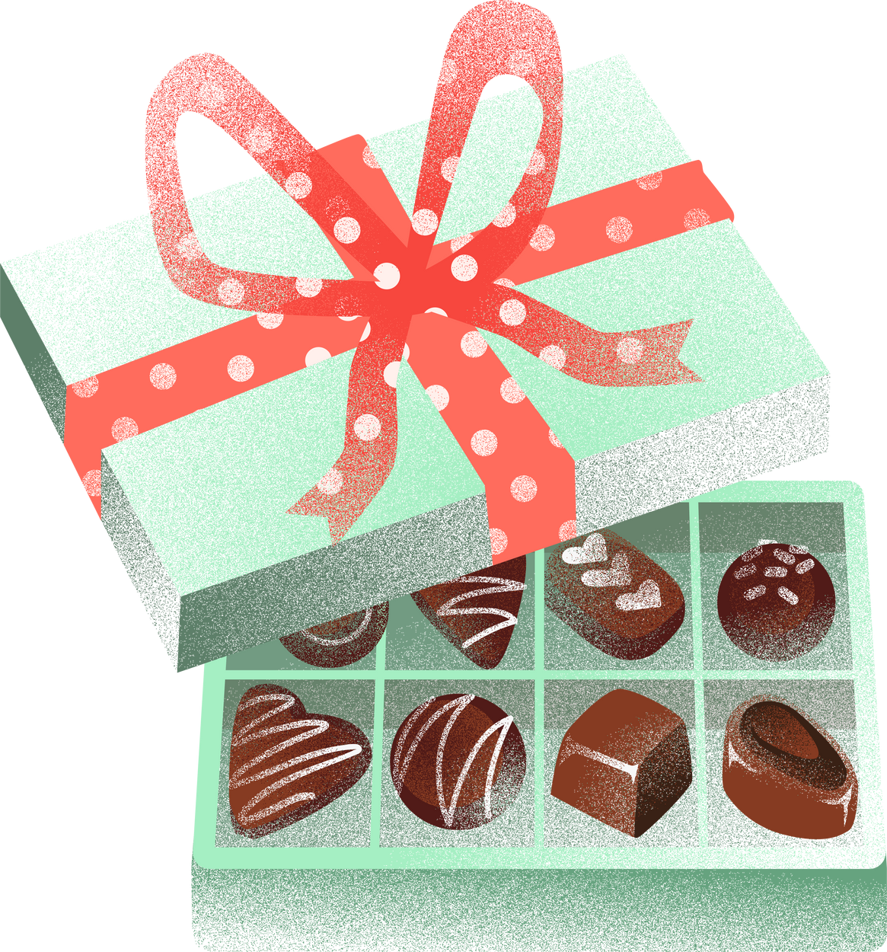



Slide 5
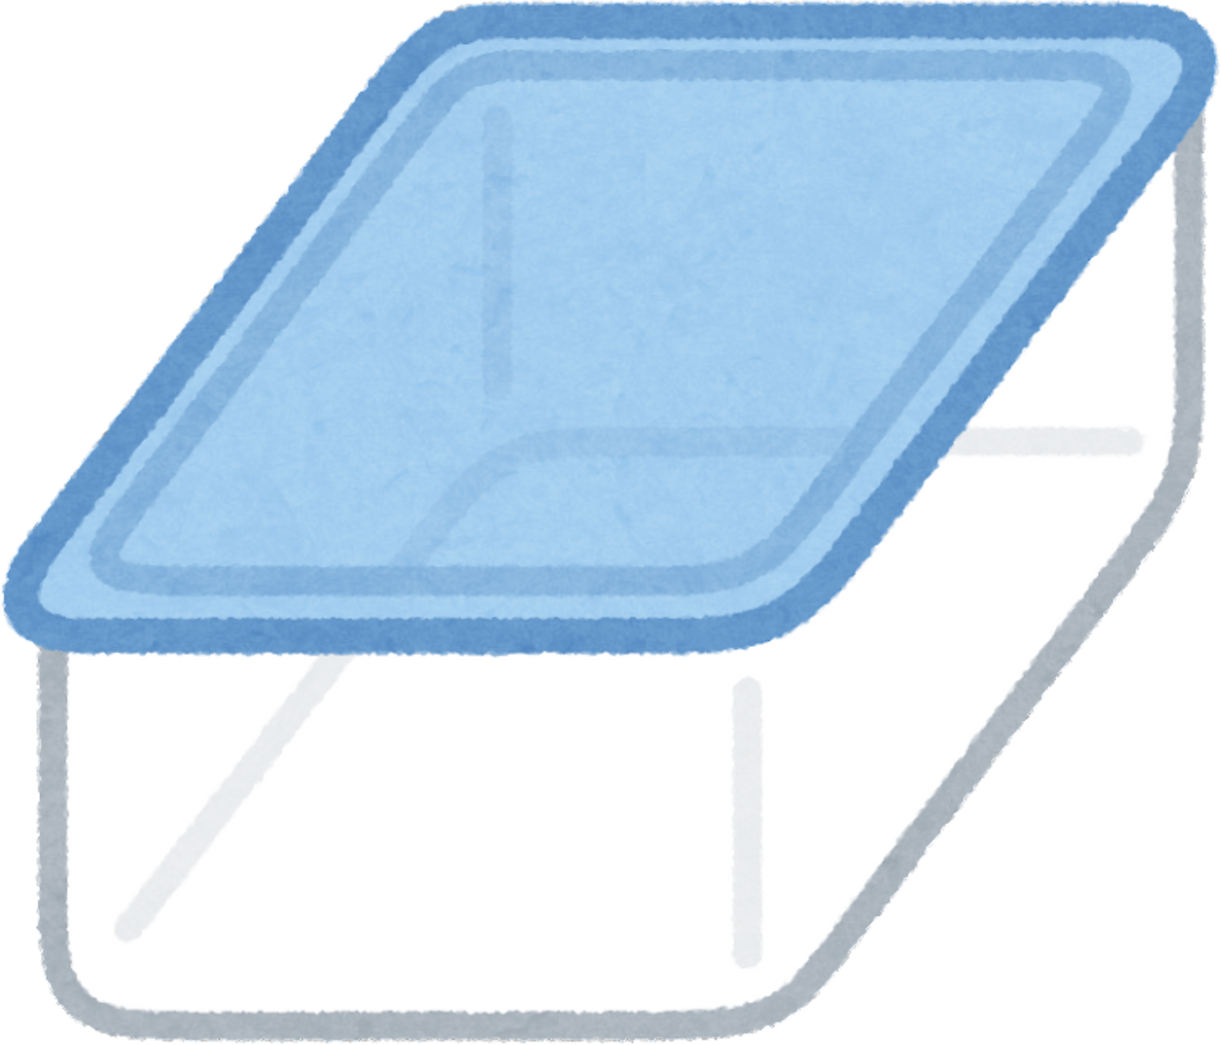
ARRAY
An array is a collection of similar type elements stored at contiguous memory locations.
2
Derived Data Type
Linear Data Structure
Data is stored in sequence
0
1

Slide 6


50 Integer Numbers
Varaibles
Arrays
int var1=1;
int var2=2;
.
.
.
int var50=50;
int var={1,2,3,....50}

Slide 7
Main reasons of using Arrays
1. Efficient Data Access
2.Better Memory Management
3.Code Simplification

